Slide 1

JANUARY 21, 2026
Recitation 2: Vscode, Debugging, and Terminal basics
ECE 312

Slide 2
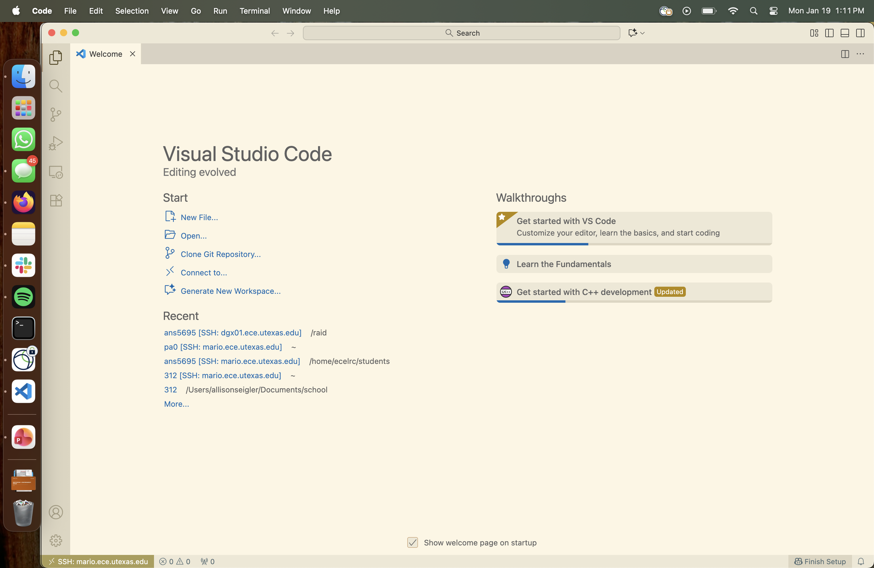
VSCode Tour
Make sure your SSH server is listed in the the corner of your window

Slide 3
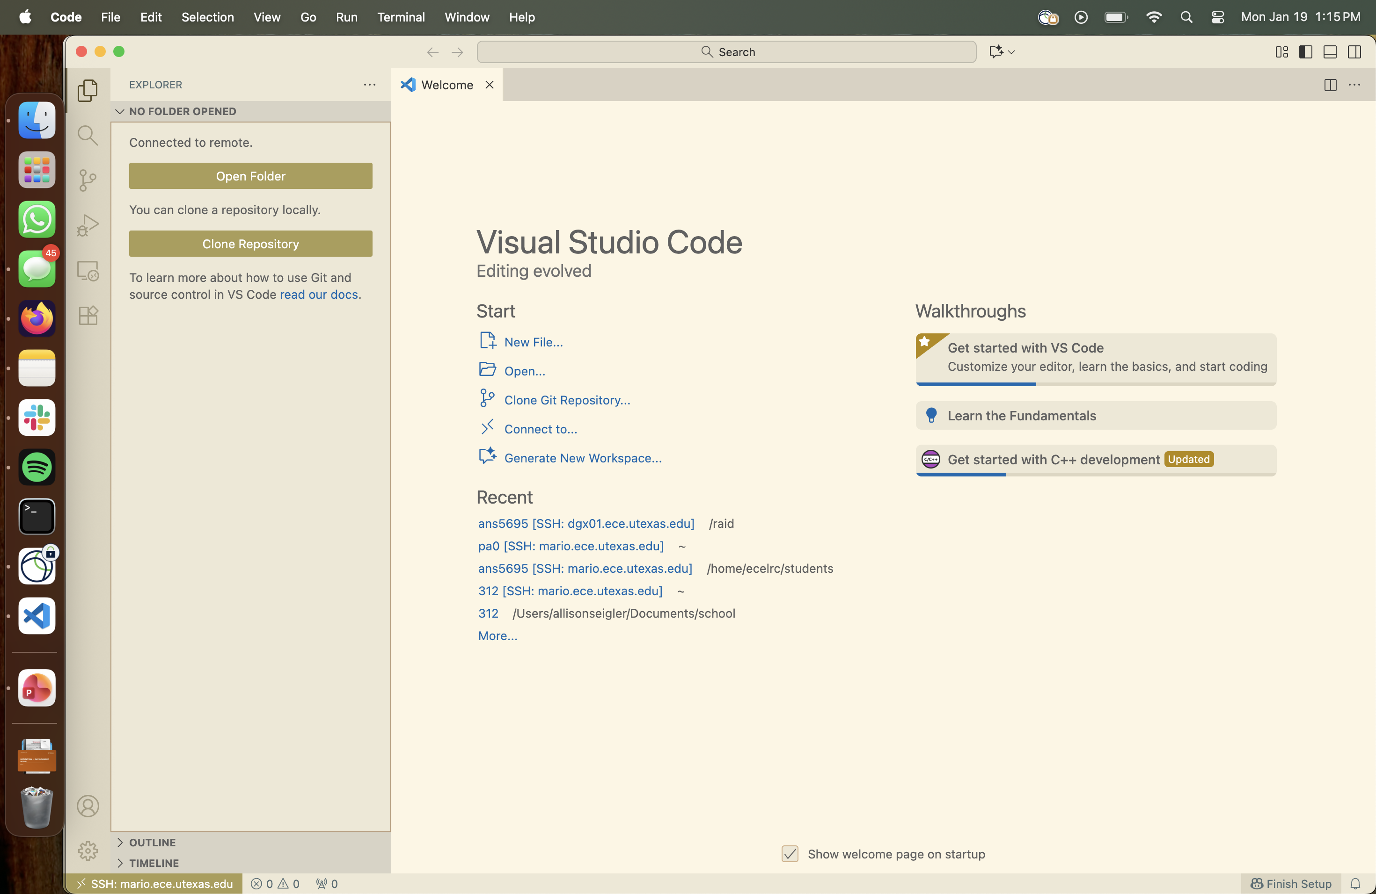
VSCode Tour
Project Folder View

Slide 4
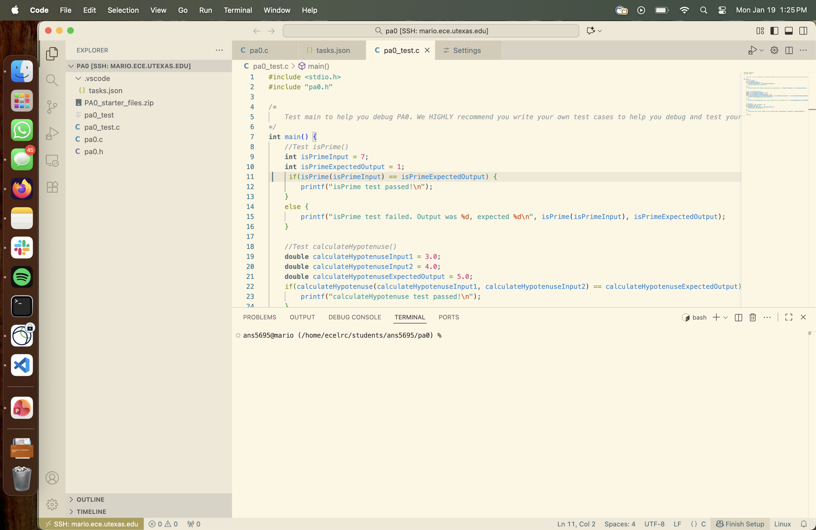
VSCode Tour
Click here to open a terminal
Terminal appears here

Slide 5
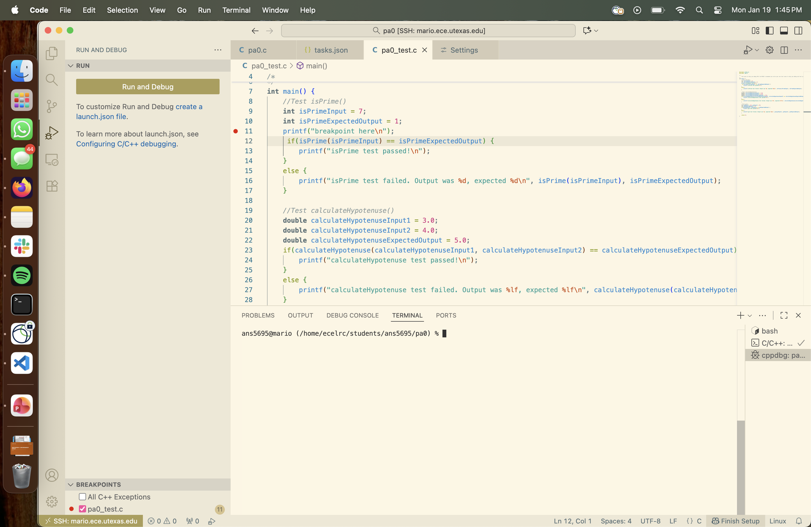
VSCode Tour
When you Run/Debug via VSCode, variable info appears in this tab

Slide 6
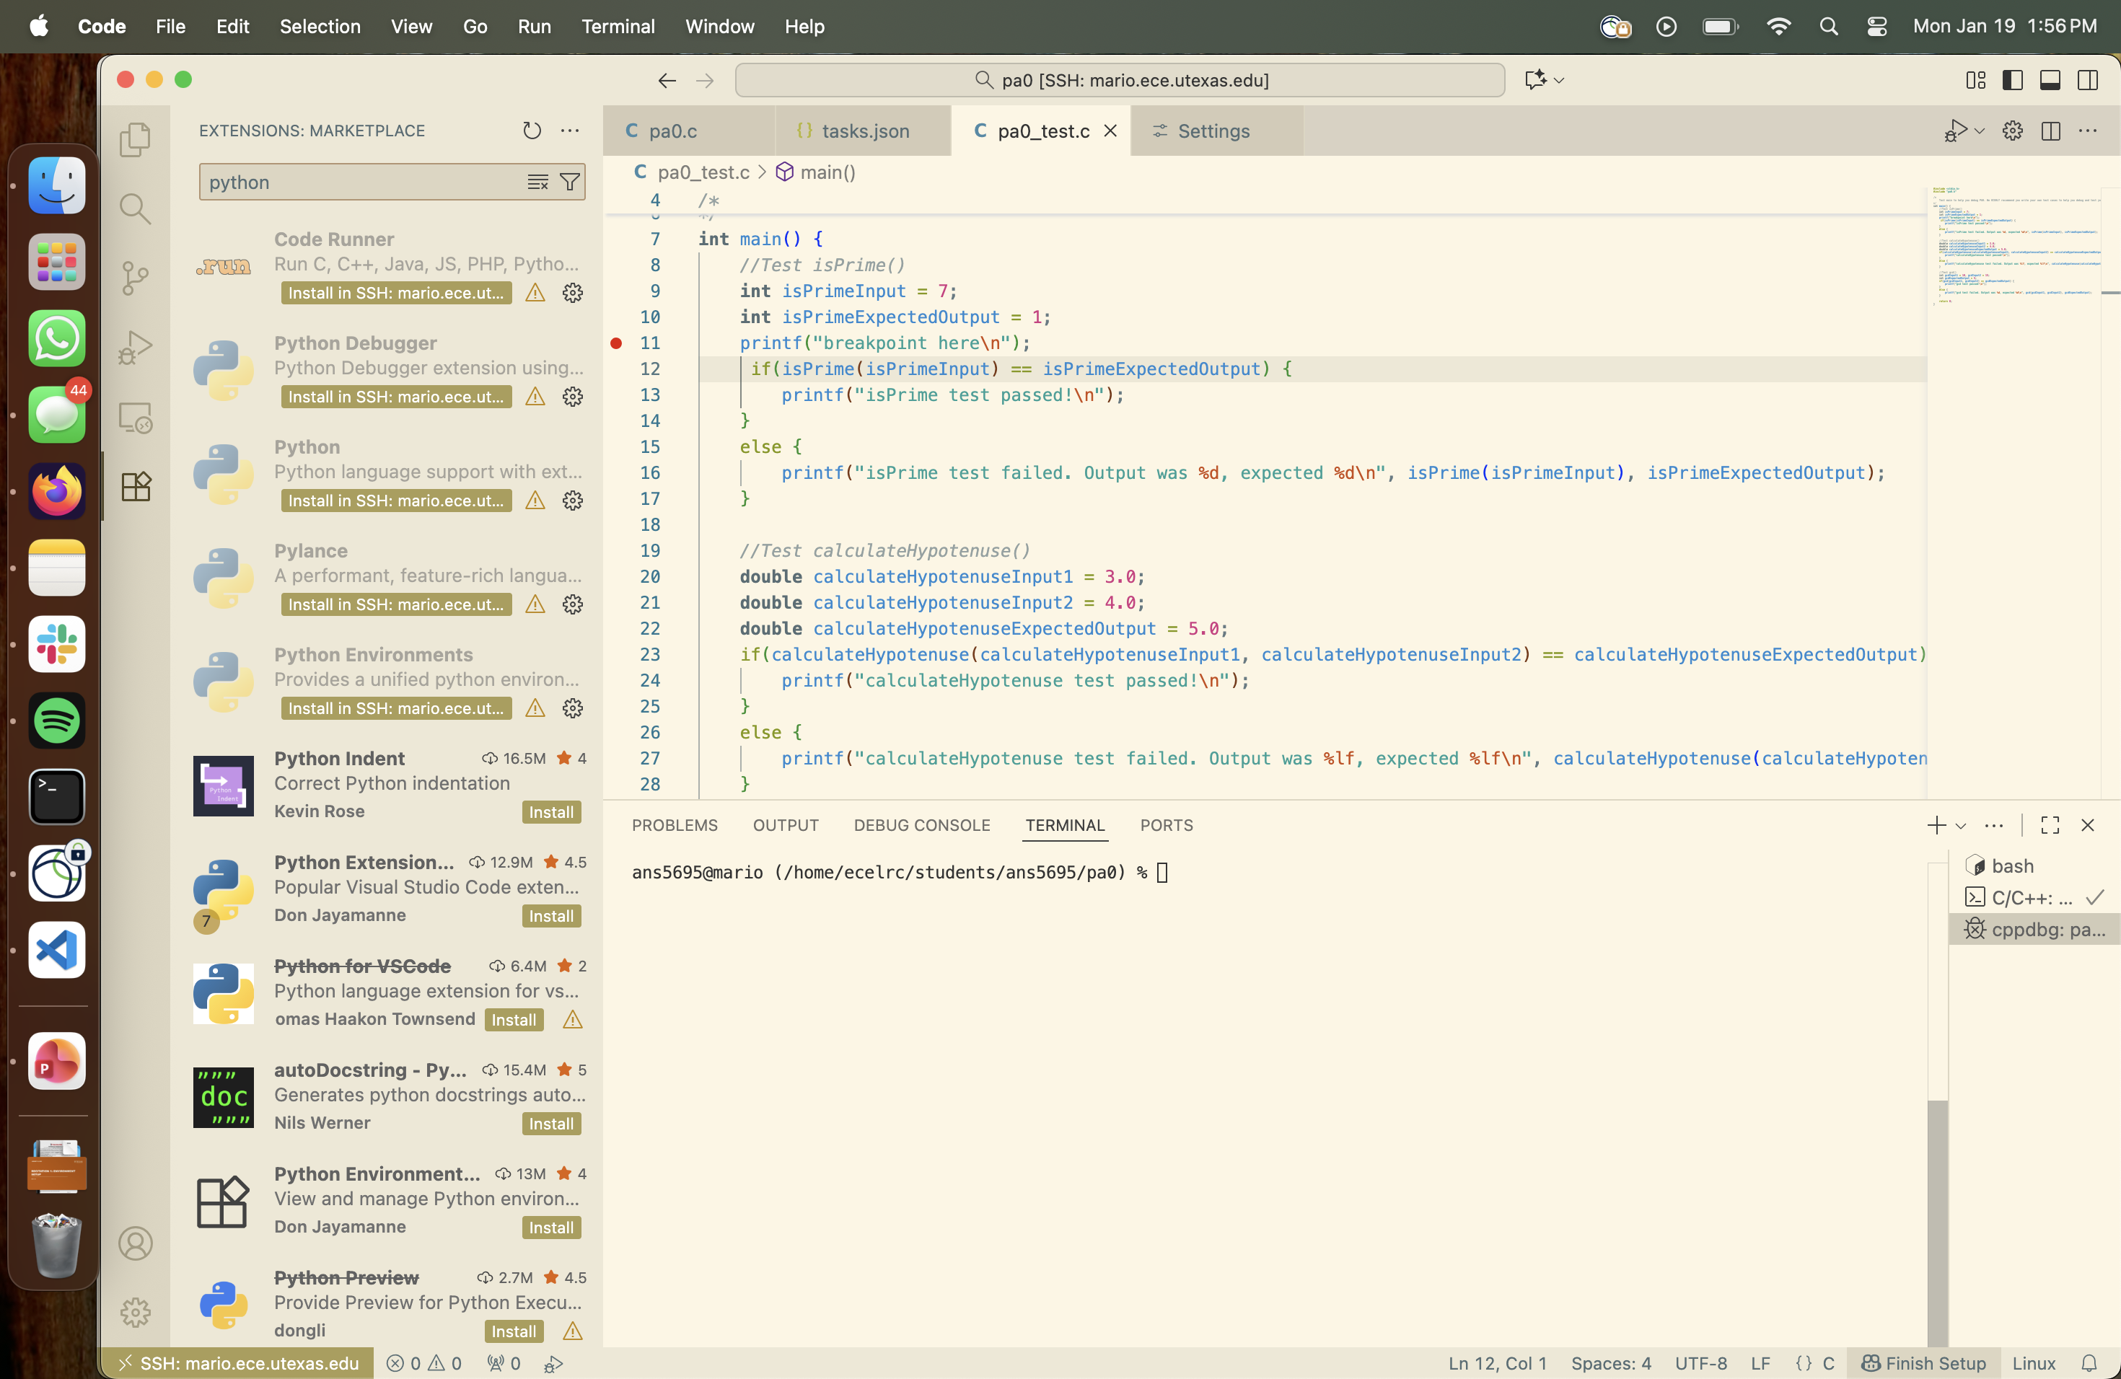
VSCode Tour
Install extensions

Slide 7
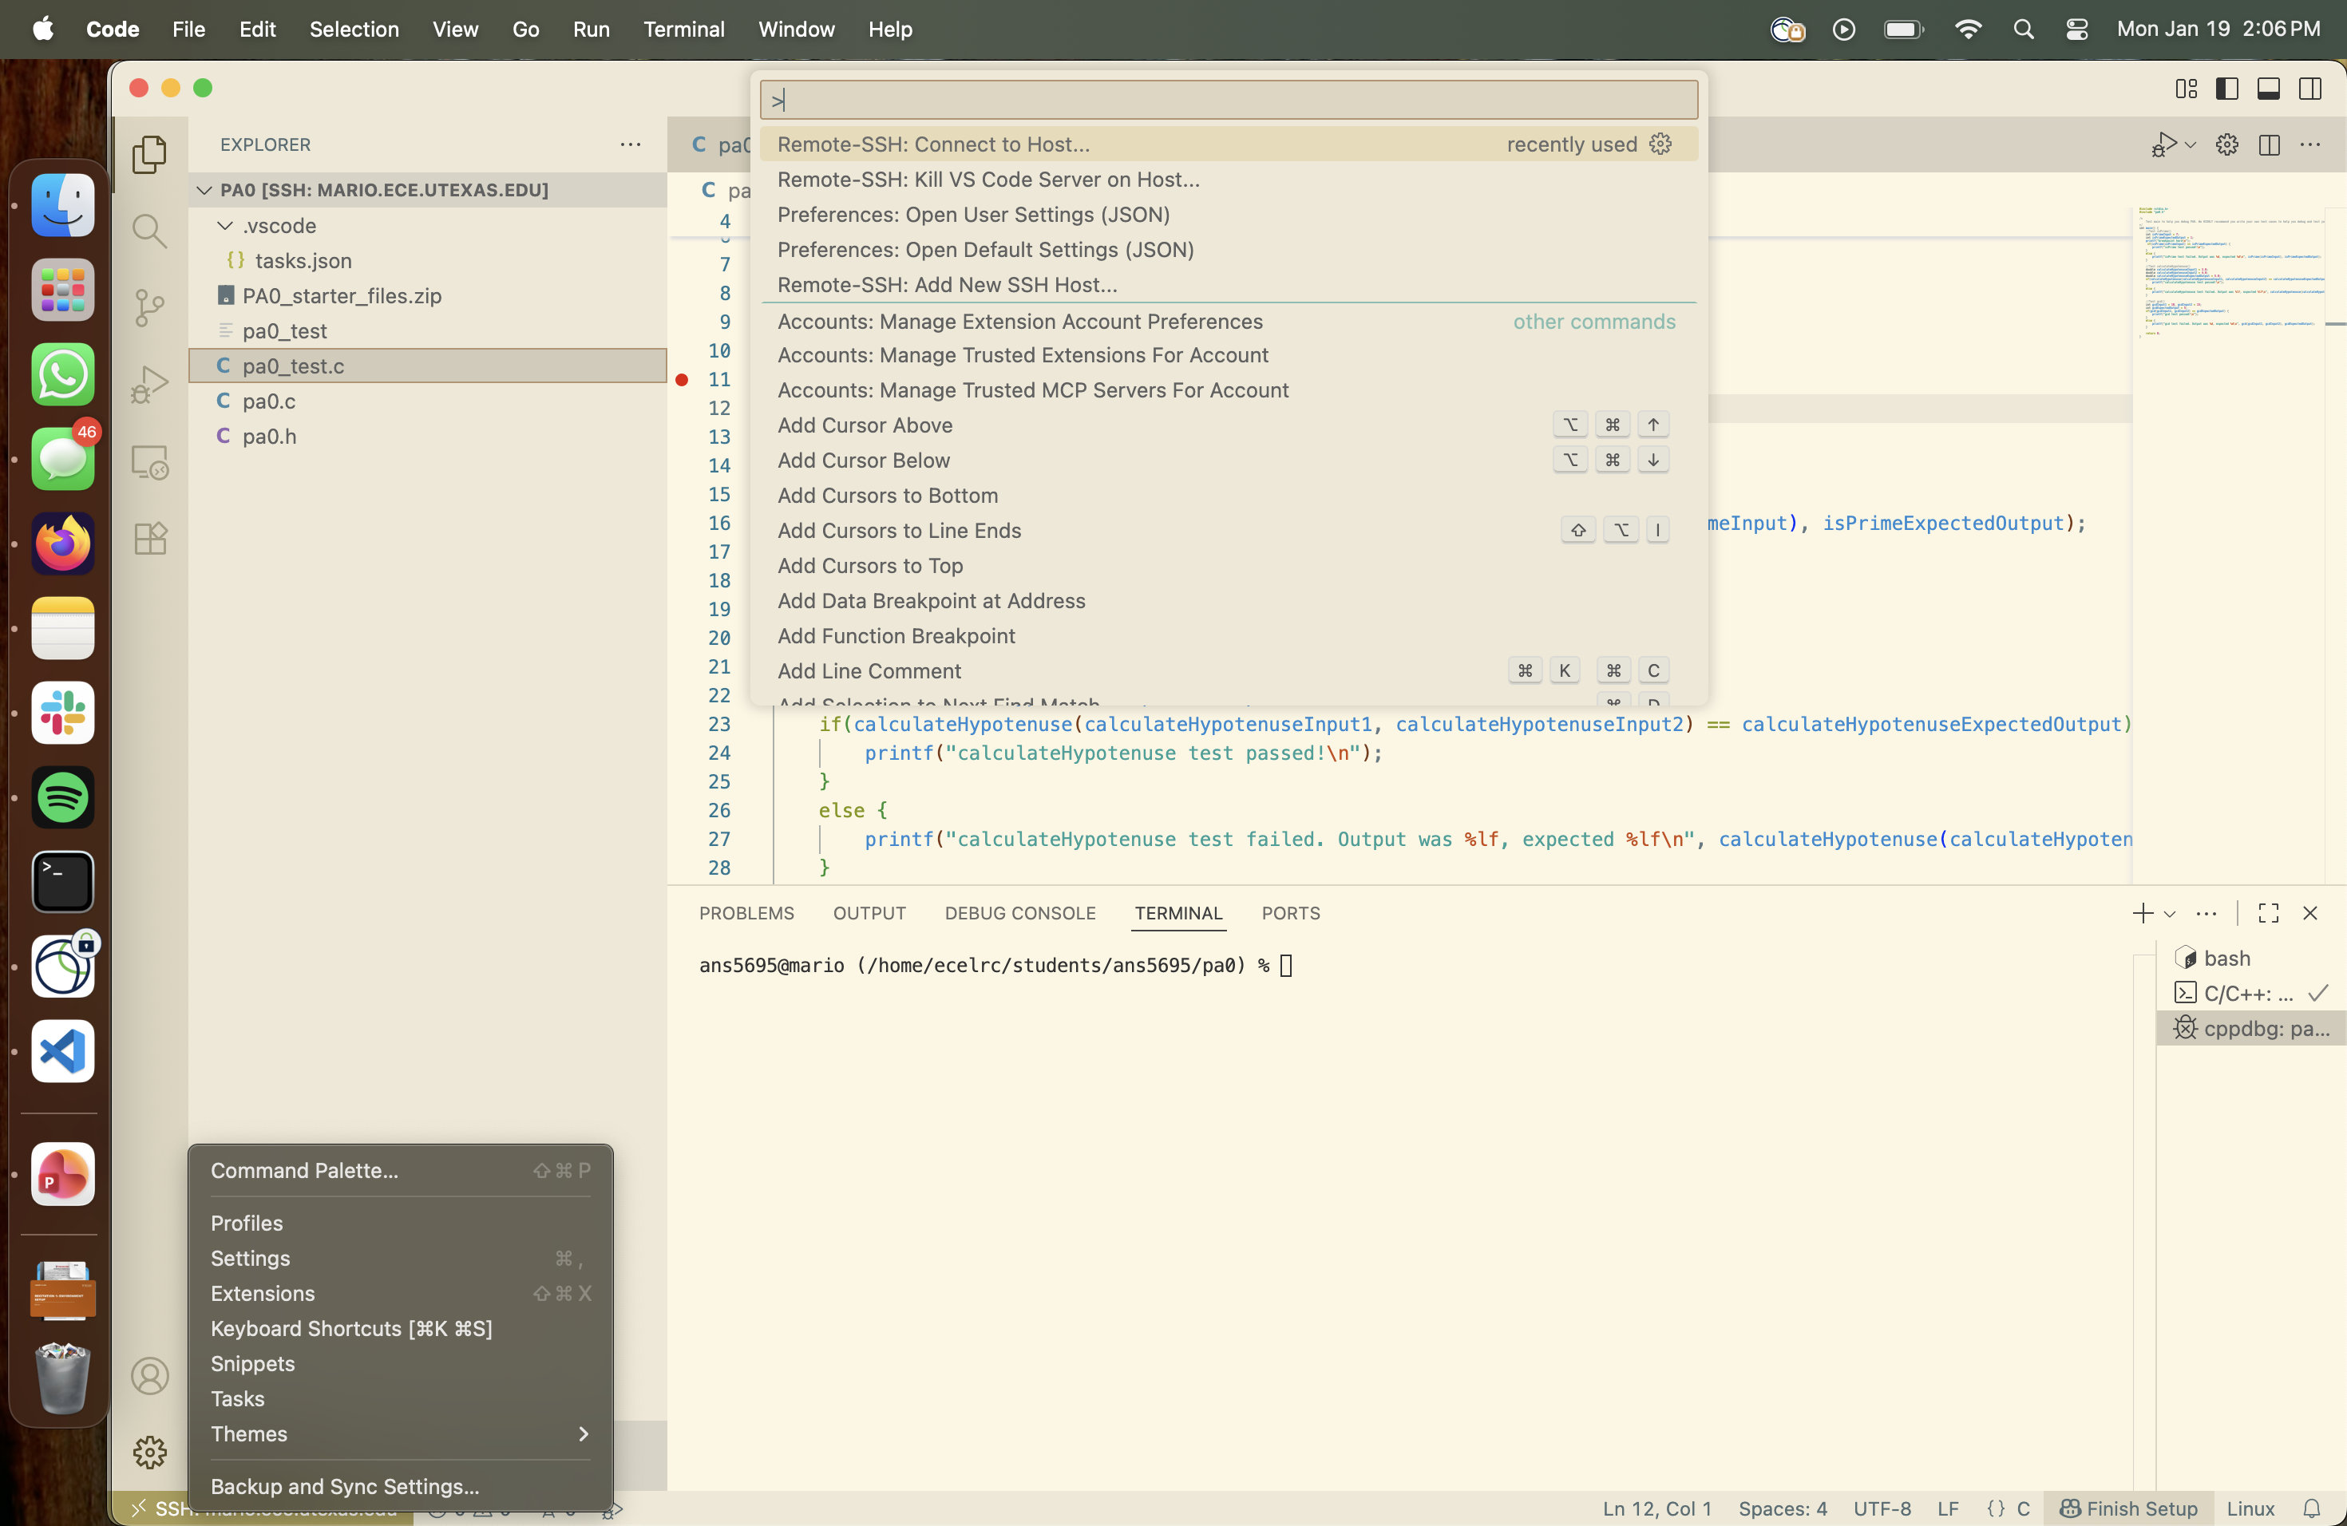
VSCode Tour
Click here to open Command Palette
You can search for settings here (including SSH Connect)

Slide 8
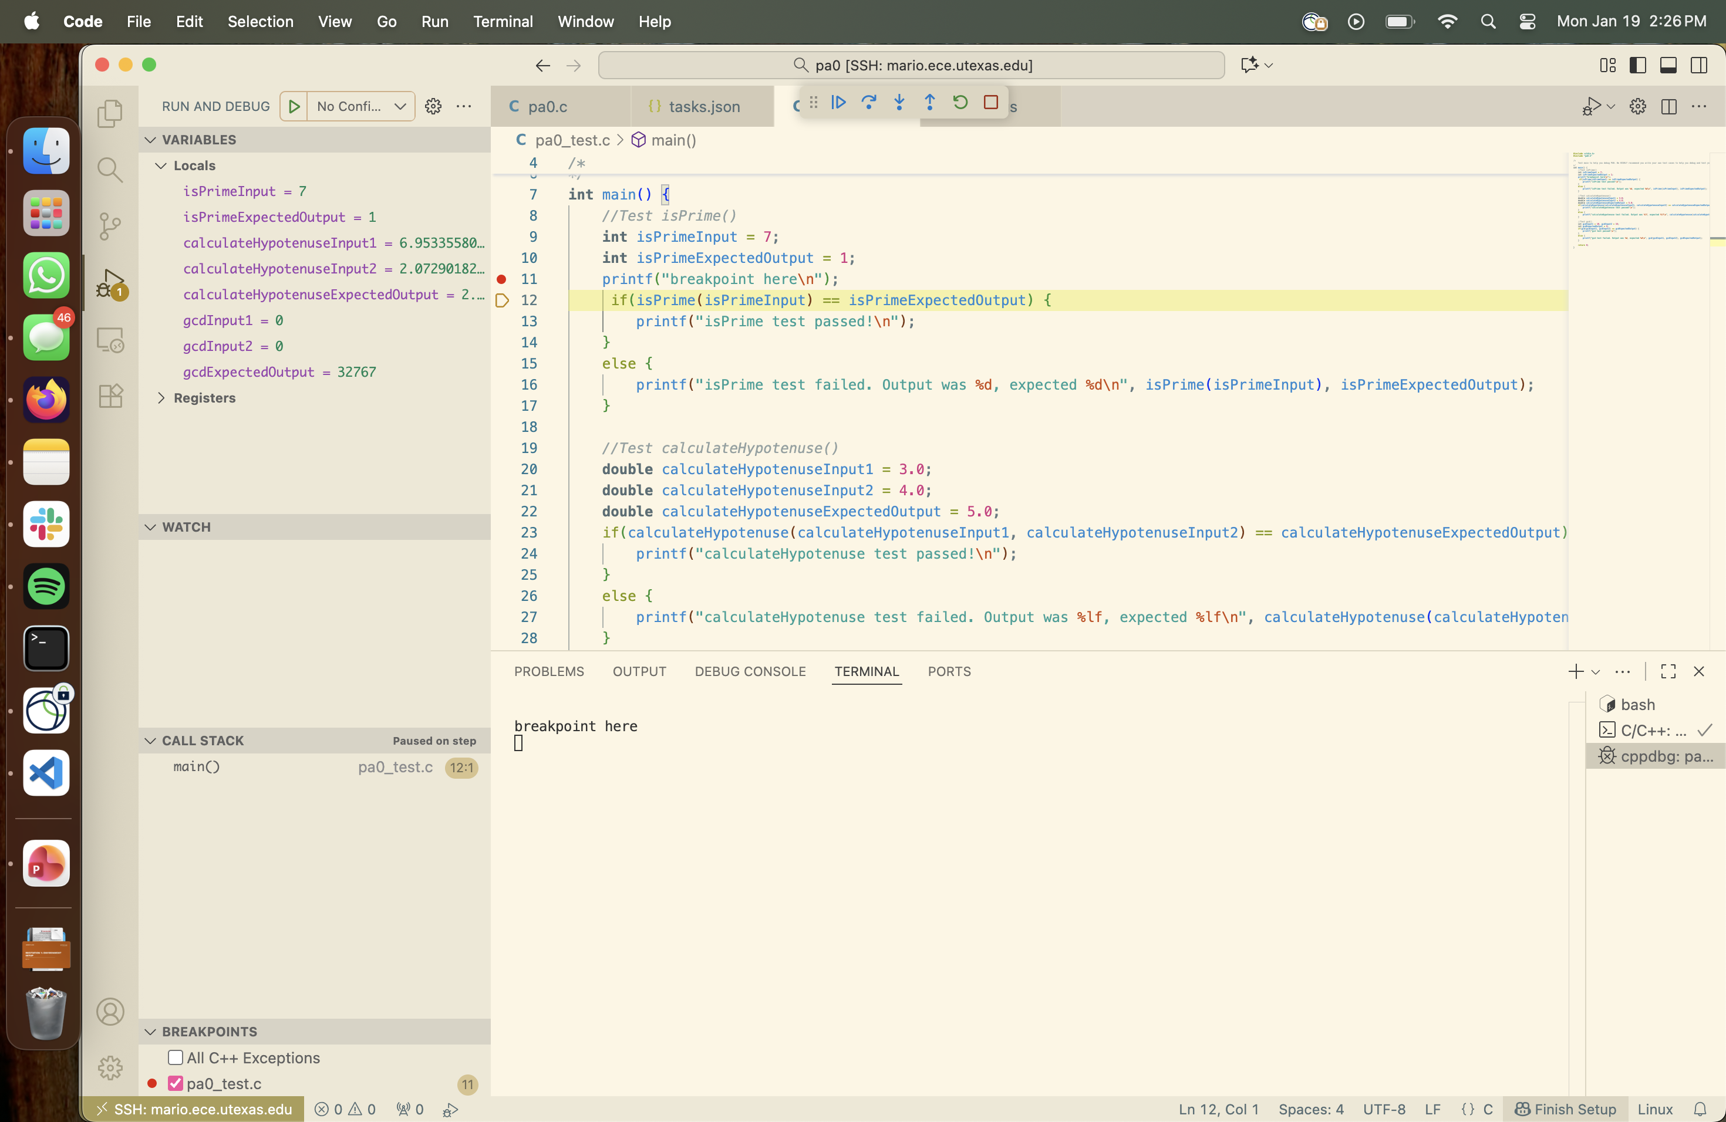
Debugging in VSCode
Continue | Step Over | Step In | Step Out | Restart | Stop
Info on variables, registers, the stack, etc.
Click a line to set a breakpoint there

Slide 9
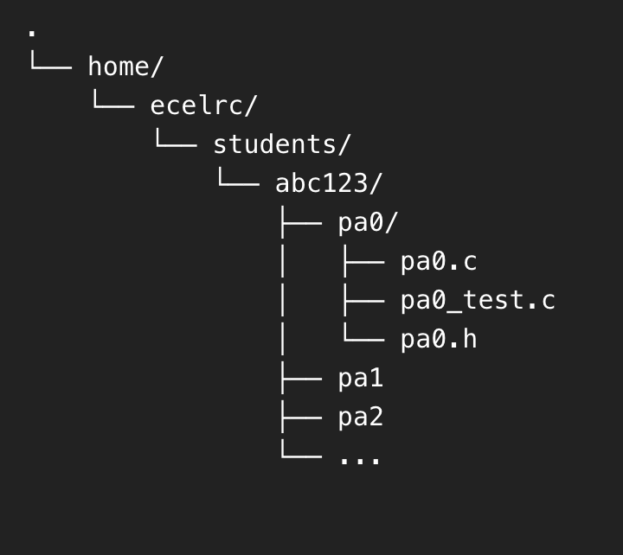
Terminal Basics
You start here
Use “pwd” to check your current location
Use “ls” to print contents
Use “cd” to change the directory you’re in

Slide 10
Quick Linux Terminal Basics
To open a terminal inside VSCode, click on “Terminal” in the top left corner, then “New Terminal”
This will give you an SSH’ed terminal in the LRC server, just embedded in the VSCode GUI
Here are some basic CLI commands
What it is | What it does
pwd | Print the path to your current directory
ls | List all files in this directory
mkdir <dirname> | Create a directory
touch <filename> | Create a file
cat <filename> | Print the contents of a file to the command line

Slide 11
Quick Linux Terminal Basics
What it is | What it does
cd <dir name> | Go to a specific directory
cd .. | Go to the directory above this
cd ~ | Go to your home directory
wget <URL> | Download a file from the internet using the provided URL
What it is | What it does
cp <file 1> <file 2> | Copy the contents of file 1 into file 2
mv <file> <dir> | Move a file into a different directory
mv <file 1> <file 2> | Change a file’s name from “file 1” to “file 2”
echo Hello World! | Print “Hello World!” to the terminal

Slide 12
Compiling and Running in Linux CLI
Compiling a C file from the command line:
gcc -o <executable name> <list of all C files>
E.g, gcc -o example example.c
Compiling a C++ file from the command line:
g++ -o <executable name> <list of all C++ files>
E.g, g++ -o example example.cpp
Running your new executable file from the command line:
./<executable name>
E.g, ./example

Slide 13
Gentle Intro to Vim
Type “vim <filename>” in terminal to open command line text editing
You use the arrow keys to get around
You need to use the keyboard to type commands before doing anything in vim
To add/delete text, type “i” to enter insert mode then type what you want
Type esc to exit insert mode
To save the file, type “:w”, to quit file editing type “:q”
There are LOTS of other shortcuts that make vim actually usable, this is just the bare minimum you need to survive

Slide 14
Questions?

